Slide 1
A MIPS Programming Model

Slide 2
A programming model is an abstract view of a processor that is appropriate for programming.
It is the view of the machine a programmer uses when programming.
Basic MIPS Programming model
Memory
Registers
Machine cycle
Control flow

Slide 3
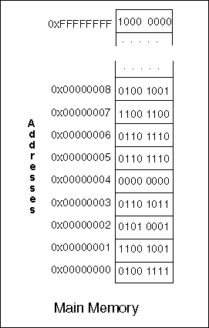
Memory Model
Memory in the programming model is as follows:
DATA:
MIPS memory is an array of 2³² bytes.
Each byte has a 32-bit address.
Each byte can hold an 8-bit pattern, one of the 256 possible 8-bit patterns.
The addresses of MIPS main memory range from 0x00000000 to 0xFFFFFFFF.

Slide 4
Memory Model
OPERATIONS:
The processor chip contains registers, which are electronic components that can store bit patterns. The processor interacts with memory by moving bit patterns between memory and its registers.
Load: a bit pattern starting at a designated address in memory is copied into a register inside the processor.
Store: a bit pattern is copied from a processor register to memory at a designated address.

Slide 5
Memory Layout
Memory is built to store bit patterns.
Both instructions and data are bit patterns, and either of these can be stored anywhere in memory.
However, it is convenient for programmers and systems software to organize memory so that instructions and data are separated
Although the address space is 32 bits, the top addresses from 0x80000000 to 0xFFFFFFFF are not available to user programs.
They are used for the operating system and for ROM (Read Only Memory

Slide 6
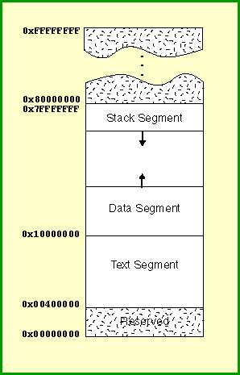
Memory Layout
The parts of address space accessible to a user program are divided as follows:
Text Segment: This holds the machine language of the user program (the text).
Data Segment: This holds the data that the program operates on. Part of the data is static. This is data that is allocated by the assembler and whose size does not change as a program executes. Values in it do change; "static" means the size in bytes does not change during execution. On top of the static data is the dynamic data. This is data that is allocated and deallocated as the program executes. In C programming, dynamic allocation and deallocation is done with malloc() and free().
Stack Segment: At the top of user address space is the stack. With high level languages, local variables and parameters are pushed and popped on the stack as procedures are activated and deactivated.

Slide 7
Registers
A register is a part of the processor that can hold a bit pattern. On the MIPS, a register holds 32 bits. There are many registers in the processor, but only some of them are visible in assembly language. The others are used by the processor in carrying out its operations.
A load operation copies a bit pattern from memory into a register.
A store operation copies a bit pattern from a register into memory.
The registers that are visible in assembly language are called general purpose registers and floating point registers.
There are 32 general purpose registers. Each general purpose register holds a 32 bit pattern. In assembly language, these registers are named $0, $1, $2, ... , $31. There are 32 floating point registers.
One of the general purpose registers is hard-wired to always contain the value 0x00000000 (all zero bits).

Slide 8
ALU
The arithmetic/logic unit (ALU) of a processor performs integer arithmetic and logical operations.
An integer used as input to an operation is called an operand. One operand for the ALU is always contained in a register. The other operand may be in a register or may be part of the machine instruction itself. The result of the operation is put into a general purpose register.

Slide 9
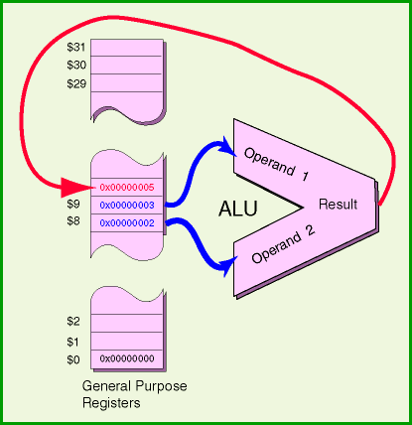
arithmetic/logic unit (ALU)
Machine instructions that use the ALU specify four things:
The operation to perform.
The the first operand (often in a register).
The second operand (often in a register).
The register that receives the result.
The picture shows a 32-bit addition operation.
The operands come from register $8 and from register $9.
The result is put in register $10. Here is how that instruction is written as assembly language:
addu $10,$8,$9

Slide 10
Questions
Store the following bit pattern into register $1 :
0xFAFBAB98
Store the bit pattern 0x0000DEDE into register $1

Slide 11
Jump and Branch Instructions
The power of programming language is to repeat actions and alter their operation depending on data.
Modern programming languages express these abilities using control structures. Repeated action (iteration) is done with a while structure. Alternative control paths (decision making/alternation) is done with an if-then-else structure.
The machine instructions of the processor do not have these tructures, nor does assembly language. In assembly language we must build these structures out of basic assembly instructions.
These basic instructions are the jump instructions and the conditional branch instructions.

Slide 12
Jump Instruction:
j instruction (jump)
Conditional Branch Instructions:
beq instruction (branch equal)
bne instruction (branch not equal)

Slide 13
Conditional branch instructions
Conditional branch instructions in MIPS have the following format:
opcode register1, register2, destination_address
where opcode is either beq (branch on equality) or bne (branch on inequality)
These instructions compare the contents of register1 and register2 to determine if they are equal.
If equal (not equal), then beq (bne) transfers control to destination_address. Otherwise, control is transferred to the next instruction in the machine language instruction sequence.

