Slide 1
Caches & Memory

Slide 2
Programs 101
C Code
RISC Assembly
int main (int argc, char* argv[ ]) {
int i;
int m = n;
int sum = 0;
for (i = 1; i <= m; i++) {
sum += i;
}
printf (“...”, n, sum);
}
main: addi sp,sp,-48
sw x1,44(sp)
sw fp,40(sp)
move fp,sp
sw x10,-36(fp)
sw x11,-40(fp)
la x15,n
lw x15,0(x15)
sw x15,-28(fp)
sw x0,-24(fp)
li x15,1
sw x15,-20(fp)
L2: lw x14,-20(fp)
lw x15,-28(fp)
blt x15,x14,L3
. . .
Load/Store Architectures:
Read data from memory (put in registers)
Manipulate it
Store it back to memory
Instructions that read from
or write to memory…

Slide 3
Programs 101
C Code
RISC Assembly
int main (int argc, char* argv[ ]) {
int i;
int m = n;
int sum = 0;
for (i = 1; i <= m; i++) {
sum += i;
}
printf (“...”, n, sum);
}
main: addi sp,sp,-48
sw ra,44(sp)
sw fp,40(sp)
move fp,sp
sw a0,-36(fp)
sw a1,-40(fp)
la a5,n
lw a5,0(x15)
sw a5,-28(fp)
sw x0,-24(fp)
li a5,1
sw a5,-20(fp)
L2: lw a4,-20(fp)
lw a5,-28(fp)
blt a5,a4,L3
. . .
Load/Store Architectures:
Read data from memory (put in registers)
Manipulate it
Store it back to memory
Instructions that read from
or write to memory…

Slide 4
1 Cycle Per Stage: the Biggest Lie (So Far)
Code Stored in Memory
(also, data and stack)
compute
jump/branch
targets
memory
register
file
A
ALU
D
D
B
+4
addr
PC
inst
control
B
d_{in}
d_{out}
M
memory
new
pc
extend
imm
forward
unit
detect
hazard
Stack, Data, Code
Stored in Memory
Instruction
Fetch
Instruction
Decode
Write-
Back
ctrl
ctrl
ctrl
Execute
Memory
IF/ID
ID/EX
EX/MEM
MEM/WB

Slide 5
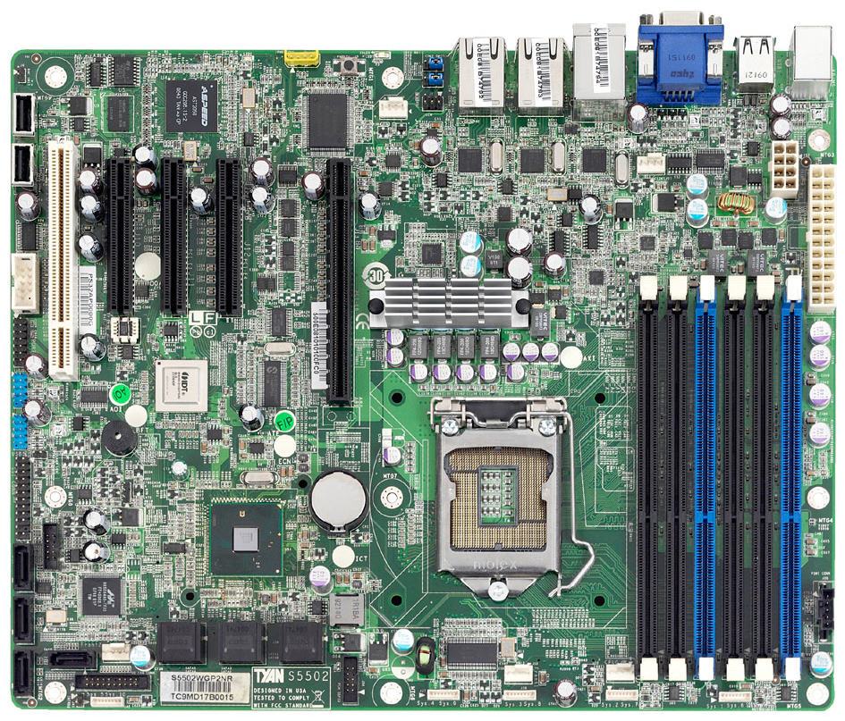
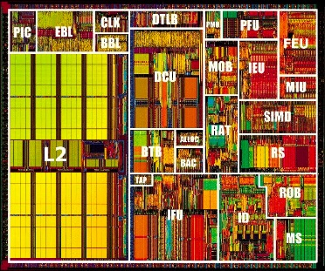
What’s the problem?
CPU
+ big
– slow
– far away
Main Memory
SandyBridge Motherboard, 2011
http://news.softpedia.com

Slide 6
What’s the solution?
Caches !
Level 1
Data $
Level 2 $
Level 1
Insn $
Intel Pentium 3, 1999

Slide 7
Locality of Data
If you ask for something, you’re likely to ask for:
the same thing again soon
→ Temporal Locality
something near that thing, soon
→ Spatial Locality
^{total = 0;}
^{for (i = 0; i < n; i++)}
^{total += a[i];}
^{return total;}

Slide 8
Locality of Data
This highlights the temporal and spatial locality of data.
Q1: Which line of code exhibits good temporal locality?
^{1 total = 0;}
^{2 for (i = 0; i < n; i++) {}
^{3 n--;}
^{4 total += a[i];}
^{5 return total;}
1
2
3
4
5

Slide 9

Locality examples
Last Called
Speed Dial
Favorites
Contacts
Google/Facebook/email

Slide 10

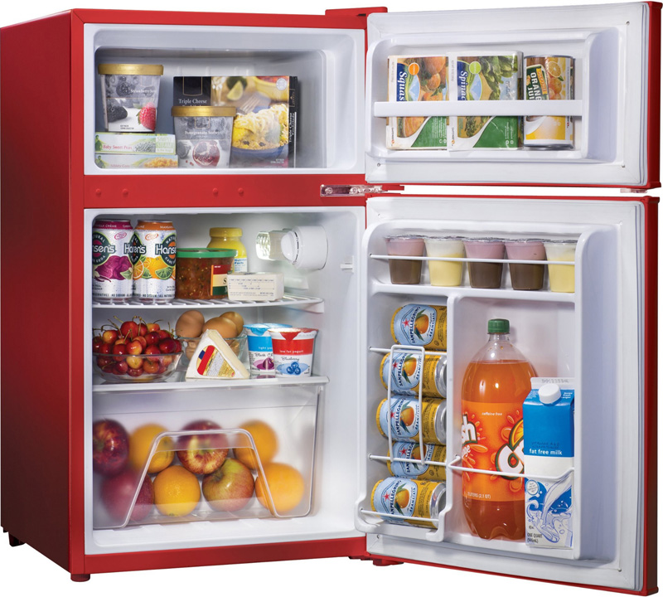


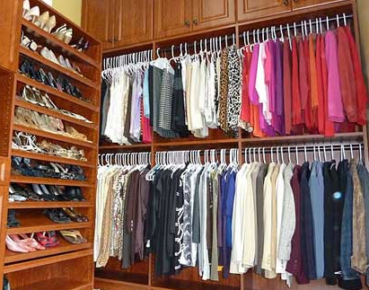
Locality

Slide 11
The Memory Hierarchy
Small, Fast
1 cycle,
128 bytes
Registers
4 cycles,
64 KB
L1 Caches
L2 Cache
12 cycles,
256 KB
L3 Cache
36 cycles,
2-20 MB
Main Memory
50-70 ns,
512 MB – 4 GB
Big, Slow
5-20 ms
16GB – 4 TB,
Disk
Intel Haswell Processor, 2013

Slide 12
Some Terminology
Cache hit
data is in the Cache
t_{hit} : time it takes to access the cache
Hit rate (%hit): # cache hits / # cache accesses
Cache miss
data is not in the Cache
t_{miss} : time it takes to get the data from below the $
Miss rate (%miss): # cache misses / # cache accesses
Cacheline or cacheblock or simply line or block
Minimum unit of info that is present/or not in the cache

Slide 13
The Memory Hierarchy
1 cycle,
128 bytes
  average access time
  t_{avg} = t_{hit} + %_{miss}* t_{miss}
  = 4 + 5% x 100
  = 9 cycles
Registers
4 cycles,
64 KB
L1 Caches
L2 Cache
12 cycles,
256 KB
L3 Cache
36 cycles,
2-20 MB
Main Memory
50-70 ns,
512 MB – 4 GB
5-20 ms
16GB – 4 TB,
Disk
Intel Haswell Processor, 2013

Slide 14
Single Core Memory Hierarchy
ON CHIP
Processor
Regs
Registers
L1 Caches
I$
D$
L2
L2 Cache
L3 Cache
Main Memory
Main Memory
Disk
Disk

Slide 15
Multi-Core Memory Hierarchy
ON CHIP
Processor
Processor
Processor
Processor
Regs
Regs
Regs
Regs
I$
D$
I$
D$
I$
D$
I$
D$
L2
L2
L2
L2
L3
Main Memory
Disk

Slide 16
Memory Hierarchy by the Numbers
CPU clock rates ~0.33ns – 2ns (3GHz-500MHz)
*Registers,D-Flip Flops: 10-100’s of registers
Memory technology | Transistor count* | Access time | Access time in cycles | $ per GIB in 2012 | Capacity
SRAM (on chip) | 6-8 transistors | 0.5-2.5 ns | 1-3 cycles | $4k | 256 KB
SRAM (off chip) |  | 1.5-30 ns | 5-15 cycles | $4k | 32 MB
DRAM | 1 transistor (needs refresh) | 50-70 ns | 150-200 cycles | $10-$20 | 8 GB
SSD (Flash) |  | 5k-50k ns | Tens of thousands | $0.75-$1 | 512 GB
Disk |  | 5M-20M ns | Millions | $0.05-$0.1 | 4 TB

Slide 17
Basic Cache Design
MEMORY
addr | data
0000 | A
0001 | B
0010 | C
0011 | D
0100 | E
0101 | F
0110 | G
0111 | H
1000 | J
1001 | K
1010 | L
1011 | M
1100 | N
1101 | O
1110 | P
1111 | Q
16 Byte Memory
load 1100 → r1
Byte-addressable memory
4 address bits → 16 bytes total
b addr bits → 2^{b} bytes in memory

Slide 18
4-Byte, Direct Mapped Cache
MEMORY
addr | data
0000 | A
0001 | B
0010 | C
0011 | D
0100 | E
0101 | F
0110 | G
0111 | H
1000 | J
1001 | K
1010 | L
1011 | M
1100 | N
1101 | O
1110 | P
1111 | Q
CACHE
index
XXXX
data
A
B
C
D
index
00
01
10
11
Cache entry
= row
= (cache) line
= (cache) block
Block Size: 1 byte
Direct mapped:
Each address maps to 1 cache block
4 entries → 2 index bits (2^{n} → n bits)
Index with LSB:
Supports spatial locality

Slide 19
4-Byte, Direct Mapped Cache
MEMORY
addr | data
0000 | A
0001 | B
0010 | C
0011 | D
0100 | E
0101 | F
0110 | G
0111 | H
1000 | J
1001 | K
1010 | L
1011 | M
1100 | N
1101 | O
1110 | P
1111 | Q
tag|index
XXXX
CACHE
tag
00
00
00
00
index
00
01
10
11
 | data
 | A
 | B
 | C
 | D
Tag: minimalist label/address
address = tag + index

Slide 20
4-Byte, Direct Mapped Cache
MEMORY
addr | data
0000 | A
0001 | B
0010 | C
0011 | D
0100 | E
0101 | F
0110 | G
0111 | H
1000 | J
1001 | K
1010 | L
1011 | M
1100 | N
1101 | O
1110 | P
1111 | Q
CACHE
index
00
01
10
11
V | tag | data
0 | 00 | X
0 | 00 | X
0 | 00 | X
0 | 00 | X
One last tweak: valid bit

Slide 21
Simulation #1 of a 4-byte, DM Cache
MEMORY
addr | data
0000 | A
0001 | B
0010 | C
0011 | D
0100 | E
0101 | F
0110 | G
0111 | H
1000 | J
1001 | K
1010 | L
1011 | M
1100 | N
1101 | O
1110 | P
1111 | Q
tag|index
XXXX
CACHE
index
00
01
10
11
V | tag | data
0 | 11 | X
0 | 11 | X
0 | 11 | X
0 | 11 | X
load 1100
Miss
Lookup:
Index into $
Check tag
Check valid bit

Slide 22
Simulation #1 of a 4-byte, DM Cache
MEMORY
addr | data
0000 | A
0001 | B
0010 | C
0011 | D
0100 | E
0101 | F
0110 | G
0111 | H
1000 | J
1001 | K
1010 | L
1011 | M
1100 | N
1101 | O
1110 | P
1111 | Q
tag|index
XXXX
CACHE
index
00
01
10
11
V | tag | data
1 | 11 | N
0 | xx | X
0 | xx | X
0 | xx | X
load 1100
Miss
Lookup:
Index into $
Check tag
Check valid bit

Slide 23
Simulation #1 of a 4-byte, DM Cache
MEMORY
addr | data
0000 | A
0001 | B
0010 | C
0011 | D
0100 | E
0101 | F
0110 | G
0111 | H
1000 | J
1001 | K
1010 | L
1011 | M
1100 | N
1101 | O
1110 | P
1111 | Q
tag|index
XXXX
CACHE
index
00
01
10
11
V | tag | data
1 | 11 | N
0 | xx | X
0 | xx | X
0 | xx | X
load 1100
...
load 1100
Miss
Lookup:
Index into $
Check tag
Check valid bit
Hit!

Slide 24
Terminology again
Cache hit
data is in the Cache
t_{hit} : time it takes to access the cache
Hit rate (%hit): # cache hits / # cache accesses
Cache miss
data is not in the Cache
t_{miss} : time it takes to get the data from below the $
Miss rate (%miss): # cache misses / # cache accesses
Cacheline or cacheblock or simply line or block
Minimum unit of info that is present/or not in the cache

Slide 25
Average memory-access time (AMAT)
There are two expressions for Average memory-access time (AMAT):
AMAT = %hit * hit time + %miss * miss time
where miss time = (hit time + miss penalty)
AMAT = %hit * hit time + %miss * (hit time + miss penalty)
AMAT = %hit * hit time + %miss * hit time + %miss * miss penalty
AMAT = hit time * (%hit + %miss) + % miss * miss penalty
AMAT = hit time + % miss * miss penalty

Slide 26
Questions
Processor A is a 1 GHz processor (1 cycle = 1 ns). There is an L1 cache with a 1 cycle access time and a 50% hit rate. There is an L2 cache with a 10 cycle access time and a 90% hit rate. It takes 100 ns to access memory.
Q1: What is the average memory access time of Processor A in ns? A: 5 B: 7 C: 9 D: 11 E: 13
Proc. B attempts to improve upon Proc. A by making the L1 cache larger. The new hit rate is 90%. To maintain a 1 cycle access time, Proc. B runs at 500 MHz (1 cycle = 2 ns).
Q2: What is the average memory access time of Processor B in ns? A: 5 B: 7 C: 9 D: 11 E: 13
Q3: Which processor should you buy?
A: Processor A B: Processor B C: They are equally good.

Slide 27
Q1:
  1 + 50% (10 + 10% x 100) =
  1 + 5 + 5 = 11 ns
Q2:
  2 + 10% (20 + 10% x 100) =
  2 + 2 + 1 = 5 ns
Processor A. Although memory access times are over 2x faster on Processor B, the frequency of Processor B is 2x slower. Since most workloads are not more than 50% memory instructions, Processor A is still likely to be the faster processor for most work- loads. (If I did have workloads that were over 50% memory instructions, Processor B might be the better choice.)

Slide 28
Block Diagram
4-entry, direct mapped Cache
tag|index
1101
CACHE
V | tag | data
1 | 00 | 1111 0000
1 | 11 | 1010 0101
0 | 01 | 1010 1010
1 | 11 | 0000 0000
2
2
2
8
=
1010 0101
data
Hit!

Slide 29
A) Hit
B) Miss
MEMORY
Simulation #2:
4-byte, DM Cache
addr | data
0000 | A
0001 | B
0010 | C
0011 | D
0100 | E
0101 | F
0110 | G
0111 | H
1000 | J
1001 | K
1010 | L
1011 | M
1100 | N
1101 | O
1110 | P
1111 | Q
CACHE
index
00
01
10
11
V | tag | data
0 | 11 | X
0 | 11 | X
0 | 11 | X
0 | 11 | X
load 1100
load 1101
load 0100
load 1100
Miss
Lookup:
Index into $
Check tag
Check valid bit
29

Slide 30
Simulation #2:
4-byte, DM Cache
MEMORY
addr | data
0000 | A
0001 | B
0010 | C
0011 | D
0100 | E
0101 | F
0110 | G
0111 | H
1000 | J
1001 | K
1010 | L
1011 | M
1100 | N
1101 | O
1110 | P
1111 | Q
CACHE
index
00
01
10
11
V | tag | data
1 | 11 | N
0 | 11 | X
0 | 11 | X
0 | 11 | X
load 1100
load 1101
load 0100
load 1100
Miss
Lookup:
Index into $
Check tag
Check valid bit

Slide 31
Clicker:
A) Hit
B) Miss
MEMORY
Simulation #2:
4-byte, DM Cache
addr | data
0000 | A
0001 | B
0010 | C
0011 | D
0100 | E
0101 | F
0110 | G
0111 | H
1000 | J
1001 | K
1010 | L
1011 | M
1100 | N
1101 | O
1110 | P
1111 | Q
CACHE
index
00
01
10
11
V | tag | data
1 | 11 | N
0 | 11 | X
0 | 11 | X
0 | 11 | X
load 1100
load 1101
load 0100
load 1100
Miss
Lookup:
Index into $
Check tag
Check valid bit
31

Slide 32
Simulation #2:
4-byte, DM Cache
MEMORY
addr | data
0000 | A
0001 | B
0010 | C
0011 | D
0100 | E
0101 | F
0110 | G
0111 | H
1000 | J
1001 | K
1010 | L
1011 | M
1100 | N
1101 | O
1110 | P
1111 | Q
tag|index
XXXX
CACHE
index
00
01
10
11
V | tag | data
1 | 11 | N
1 | 11 | O
0 | 11 | X
0 | 11 | X
load 1100
load 1101
load 0100
load 1100
Miss
Lookup:
Index into $
Check tag
Check valid bit
Miss

Slide 33
Clicker:
A) Hit
B) Miss
MEMORY
Simulation #2:
4-byte, DM Cache
addr | data
0000 | A
0001 | B
0010 | C
0011 | D
0100 | E
0101 | F
0110 | G
0111 | H
1000 | J
1001 | K
1010 | L
1011 | M
1100 | N
1101 | O
1110 | P
1111 | Q
CACHE
index
00
01
10
11
V | tag | data
1 | 11 | N
1 | 11 | O
0 | 11 | X
0 | 11 | X
load 1100
load 1101
load 0100
load 1100
Miss
Lookup:
Index into $
Check tag
Check valid bit
Miss
Miss
33

Slide 34
Simulation #2:
4-byte, DM Cache
MEMORY
addr | data
0000 | A
0001 | B
0010 | C
0011 | D
0100 | E
0101 | F
0110 | G
0111 | H
1000 | J
1001 | K
1010 | L
1011 | M
1100 | N
1101 | O
1110 | P
1111 | Q
tag|index
XXXX
CACHE
index
00
01
10
11
V | tag | data
1 | 01 | E
1 | 11 | O
0 | 11 | X
0 | 11 | X
load 1100
load 1101
load 0100
load 1100
Miss
Lookup:
Index into $
Check tag
Check valid bit
Miss
Miss

Slide 35
Clicker:
A) Hit
B) Miss
MEMORY
Simulation #2:
4-byte, DM Cache
addr | data
0000 | A
0001 | B
0010 | C
0011 | D
0100 | E
0101 | F
0110 | G
0111 | H
1000 | J
1001 | K
1010 | L
1011 | M
1100 | N
1101 | O
1110 | P
1111 | Q
CACHE
index
00
01
10
11
V | tag | data
1 | 01 | E
1 | 11 | O
0 | 11 | X
0 | 11 | X
load 1100
load 1101
load 0100
load 1100
Miss
Lookup:
Index into $
Check tag
Check valid bit
Miss
Miss
Miss

Slide 36
MEMORY
Simulation #2:
4-byte, DM Cache
addr | data
0000 | A
0001 | B
0010 | C
0011 | D
0100 | E
0101 | F
0110 | G
0111 | H
1000 | J
1001 | K
1010 | L
1011 | M
1100 | N
1101 | O
1110 | P
1111 | Q
tag|index
XXXX
CACHE
index
00
01
10
11
V | tag | data
1 | 11 | N
1 | 11 | O
0 | 11 | X
0 | 11 | X
load 1100
load 1101
load 0100
load 1100
Miss
Miss
Miss
Miss
36

Slide 37
Increasing Block Size
MEMORY
addr | data
0000 | A
0001 | B
0010 | C
0011 | D
0100 | E
0101 | F
0110 | G
0111 | H
1000 | J
1001 | K
1010 | L
1011 | M
1100 | N
1101 | O
1110 | P
1111 | Q
CACHE
offset
XXXX
index
00
01
10
11
V | tag | data
0 | x | A | B
0 | x | C | D
0 | x | E | F
0 | x | G | H
Block Size: 2 bytes
Block Offset: least significant bits indicate where you live in the block
Which bits are the index? tag?

Slide 38
Simulation #3:
8-byte, DM Cache
MEMORY
addr | data
0000 | A
0001 | B
0010 | C
0011 | D
0100 | E
0101 | F
0110 | G
0111 | H
1000 | J
1001 | K
1010 | L
1011 | M
1100 | N
1101 | O
1110 | P
1111 | Q
index
CACHE
tag| |offset
XXXX
index
00
01
10
11
V | tag | data
0 | x | X | X
0 | x | X | X
0 | x | X | X
0 | x | X | X
load 1100
load 1101
load 0100
load 1100
Miss
Lookup:
Index into $
Check tag
Check valid bit

Slide 39
Simulation #3:
8-byte, DM Cache
MEMORY
addr | data
0000 | A
0001 | B
0010 | C
0011 | D
0100 | E
0101 | F
0110 | G
0111 | H
1000 | J
1001 | K
1010 | L
1011 | M
1100 | N
1101 | O
1110 | P
1111 | Q
index
CACHE
tag| |offset
XXXX
index
00
01
10
11
V | tag | data
0 | x | X | X
0 | x | X | X
1 | 1 | N | O
0 | x | X | X
load 1100
load 1101
load 0100
load 1100
Miss
Lookup:
Index into $
Check tag
Check valid bit

Slide 40
Simulation #3:
8-byte, DM Cache
MEMORY
addr | data
0000 | A
0001 | B
0010 | C
0011 | D
0100 | E
0101 | F
0110 | G
0111 | H
1000 | J
1001 | K
1010 | L
1011 | M
1100 | N
1101 | O
1110 | P
1111 | Q
index
CACHE
tag| |offset
XXXX
index
00
01
10
11
V | tag | data
0 | x | X | X
0 | x | X | X
1 | 1 | N | O
0 | x | X | X
load 1100
load 1101
load 0100
load 1100
Miss
Lookup:
Index into $
Check tag
Check valid bit
Hit!

Slide 41
Simulation #3:
8-byte, DM Cache
MEMORY
addr | data
0000 | A
0001 | B
0010 | C
0011 | D
0100 | E
0101 | F
0110 | G
0111 | H
1000 | J
1001 | K
1010 | L
1011 | M
1100 | N
1101 | O
1110 | P
1111 | Q
index
CACHE
tag| |offset
XXXX
index
00
01
10
11
V | tag | data
0 | x | X | X
0 | x | X | X
1 | 1 | N | O
0 | x | X | X
load 1100
load 1101
load 0100
load 1100
Miss
Lookup:
Index into $
Check tag
Check valid bit
Hit!
Miss

Slide 42
Simulation #3:
8-byte, DM Cache
MEMORY
addr | data
0000 | A
0001 | B
0010 | C
0011 | D
0100 | E
0101 | F
0110 | G
0111 | H
1000 | J
1001 | K
1010 | L
1011 | M
1100 | N
1101 | O
1110 | P
1111 | Q
index
CACHE
tag| |offset
XXXX
index
00
01
10
11
V | tag | data
0 | x | X | X
0 | x | X | X
1 | 0 | E | F
0 | x | X | X
load 1100
load 1101
load 0100
load 1100
Miss
Lookup:
Index into $
Check tag
Check valid bit
Hit!
Miss

Slide 43
Simulation #3:
8-byte, DM Cache
MEMORY
addr | data
0000 | A
0001 | B
0010 | C
0011 | D
0100 | E
0101 | F
0110 | G
0111 | H
1000 | J
1001 | K
1010 | L
1011 | M
1100 | N
1101 | O
1110 | P
1111 | Q
index
CACHE
tag| |offset
XXXX
index
00
01
10
11
V | tag | data
0 | x | X | X
0 | x | X | X
1 | 0 | E | F
0 | x | X | X
load 1100
load 1101
load 0100
load 1100
Miss
Lookup:
Index into $
Check tag
Check valid bit
Hit!
Miss
Miss

Slide 44
Simulation #3:
8-byte, DM Cache
MEMORY
addr | data
0000 | A
0001 | B
0010 | C
0011 | D
0100 | E
0101 | F
0110 | G
0111 | H
1000 | J
1001 | K
1010 | L
1011 | M
1100 | N
1101 | O
1110 | P
1111 | Q
CACHE
index
00
01
10
11
V | tag | data
0 | x | X | X
0 | x | X | X
1 | 0 | E | F
0 | x | X | X
load 1100
load 1101
load 0100
load 1100
Miss
cold
1 hit, 3 misses
3 bytes don’t fit in a 4 entry cache?
Hit!
Miss
cold
Miss
conflict

