Slide 1
Processor: Datapath and Control
Single cycle processor
Datapath and Control
Multicycle processor
Datapath and Control

Slide 2
Processor Design
Processor design
datapath and control unit design
processor design determines
clock cycle time
clock cycles per instruction
Performance of a machine is determined by
Instruction count
clock cycle time
clock cycles per instruction

Slide 3
How to Design a Processor: step-by-step
1. Analyze instruction set => datapath requirements
the meaning of each instruction is given by the register transfers
datapath must include storage element for ISA registers
possibly more
datapath must support each register transfer
2. Select set of datapath components and establish clocking methodology
3. Assemble datapath meeting the requirements
4. Analyze implementation of each instruction to determine setting of control points that effects the register transfer.
5. Assemble the control logic

Slide 4
Single Cycle Processor
Single cycle processor
Pros: one clock cycle per instruction
Cons: too long cycle time, too low clocking frequency
Design a processor
analyze instruction set (the meaning of each instruction is given by the register transfers)
timing of each instruction
datapath support each register transfer
select datapath components and establish clocking methodology
analyze implementation of each instruction to determine setting of control points that affect register transfer
assemble control logic and datapath components

Slide 5
Clocking Methodology
Edge-triggered clock
setup time
hold time
all storage elements clocked by the same clock
combinational logic block:
inputs are updated at each clock tick
all outputs must be stable before the next clock tick

Slide 6
Clocked Logic Timing

Slide 7
Timing Analysis, Logic Delay
What is the smallest T that produces correct operation?
Worst case CL delay limits T.

Slide 8
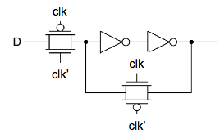
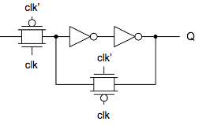
Flip Flop delays:
clk-to-Q ?
setup ?
hold ?
D
Q
CLK
CLK == 0
Sense D, but Q
outputs old value.
setup
CLK 0->1
Capture D, pass
value to Q
hold
clk-to-Q

Slide 9
Flip Flops have internal delays
Value of D is sampled on positive clock edge.
D
Q
Q outputs sampled value for rest of cycle.
t_setup
CLK
CLK
D
Q
t_clk-to-Q

Slide 10
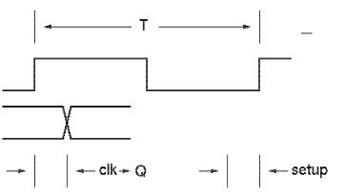
Combinational Logic
ALU “time budget”

Slide 11
The MIPS Instruction Formats
All MIPS instructions are 32 bits long. The three instruction formats:
R-type
I-type
J-type
The different fields are:
op: operation of the instruction
rs, rt, rd: the source and destination register specifiers
shamt: shift amount
funct: selects the variant of the operation in the “op” field
address / immediate: address offset or immediate value
target address: target address of the jump instruction
31
26
21
16
11
6
0
op
rs
rt
rd
shamt
funct
6 bits
5 bits
5 bits
5 bits
5 bits
6 bits
31
26
21
16
0
op
rs
rt
immediate
6 bits
5 bits
5 bits
16 bits
31
26
0
op
target address
6 bits
26 bits

Slide 12
Register Transfers
add $1, $2, $3; rs = $2, rt = $3, rd = $1
R[rd] <- R[rs] + R[rt} PC <- PC + 4
sub $1, $2, $3; rs = $2, rt = $3, rd = $1
R[rd] <- R[rs] - R[rt] PC <- PC + 4
ori $1, $2, 20; rs = $2, rt = $1
R[rt] <- R[rs] + zero_ext(imm16) PC <- PC + 4
lw $1, 200($2); rs = $2, rt = $1
R[rt] <- MEM{R[rs] + sign_ext(imm16)} PC <- PC + 4
sw $1, 200($2); rs = $2, rt = $1
MEM{R[rs] + sign_ext(imm16)} <- R[rt] PC <- PC + 4

Slide 13
Components
Memory: hold instruction and data
Registers: 32 32-bit registers
read rs
read rt
write rd
write rt
Program counter
Extender
Add and Sub registers or extended immediates
Add 4 to PC or Add extended immediate to PC (jump inst)

Slide 14
Combinational Logic Elements
CarryIn
A
(to add values)
(to chose between values)
(to do add, subtract, or)
Adder
MUX (multi-plexor)
ALU
32
Adder
Sum
32
B
Carry
32
Select
A
32
MUX
Y
32
B
32
OP
A
32
ALU
Result
32
B
32

Slide 15
Storage Element: Register (Basic Building Block)
Register
Similar to the D Flip Flop except
N-bit input and output
Write Enable input
Write Enable:
negated (0): Data Out will not change
asserted (1): Data Out will become Data In
Write Enable
Data In
Data Out
N
N
Clk

Slide 16
Sequential Logic Elements
Registers: n-bit input and output, D F/F, write enable
rs, rt, rd : register specifiers
read
register1
read
data1
read
register2
write
register
write
data
read
data2
registers

Slide 17
Fetching Instructions
Fetching instructions involves
reading the instruction from the Instruction Memory
updating the PC to hold the address of the next instruction
Add
4
Instruction
Memory
PC
Read
Address
Instruction
PC is updated every cycle, so it does not need an explicit write control signal
Instruction Memory is read every cycle, so it doesn’t need an explicit read control signal

Slide 18
Decoding Instructions
Decoding instructions involves
sending the fetched instruction’s opcode and function field bits to the control unit
Control
Unit
Read Addr 1
Read Addr 1
Read
Data 1
Register
File
Read
Data 1
Register
File
Read Addr 2
Instruction
Read Addr 2
Write Addr
Write Addr
Read
Data 2
Read
Data 2
Write Data
Write Data
reading two values from the Register File
Register File addresses are contained in the instruction

Slide 19
Executing R Format Operations
R format operations (add, sub, slt, and, or)
perform the (op and funct) operation on values in rs and rt
store the result back into the Register File (into location rd)
31
25
20
15
10
5
0
R-type:
op
rs
rt
rd
shamt
funct
RegWrite
ALU control
Read Addr 1
Register
File
Read
Data 1
Instruction
Read Addr 2
overflow
ALU
zero
Write Addr
Read
Data 2
Write Data
The Register File is not written every cycle (e.g. sw), so we need an explicit write control signal for the Register File

Slide 20
Executing Load and Store Operations
Load and store operations involves
compute memory address by adding the base register (read from the Register File during decode) to the 16-bit signed-extended offset field in the instruction
store value (read from the Register File during decode) written to the Data Memory
load value, read from the Data Memory, written to the Register File
RegWrite
ALU control
MemWrite
overflow
Read Addr 1
zero
Register
File
Read
Data 1
Address
Instruction
Read Addr 2
Data
Memory
ALU
Read Data
Write Addr
Read
Data 2
Write Data
Write Data
Sign
Extend
MemRead
16
32

Slide 21
Executing Branch Operations
Branch operations involves
compare the operands read from the Register File during decode for equality (zero ALU output)
compute the branch target address by adding the updated PC to the 16-bit signed-extended offset field in the instr
Add
Branch
target
address
4
Add
Shift
left 2
ALU control
PC
Read Addr 1
zero
(to branch control logic)
Register
File
Read
Data 1
Instruction
Read Addr 2
Write Addr
ALU
Read
Data 2
Write Data
Sign
Extend
16
32

Slide 22
Executing Jump Operations
Jump operation involves
replace the lower 28 bits of the PC with the lower 26 bits of the fetched instruction shifted left by 2 bits
Add
4
4
Jump
address
Instruction
Memory
Shift
left 2
28
PC
Read
Address
Instruction
26

Slide 23
Creating a Single Datapath from the Parts
Assemble the datapath segments and add control lines and multiplexors as needed
Single cycle design – fetch, decode and execute each instructions in one clock cycle
no datapath resource can be used more than once per instruction, so some must be duplicated (e.g., separate Instruction Memory and Data Memory, several adders)
multiplexors needed at the input of shared elements with control lines to do the selection
write signals to control writing to the Register File and Data Memory
Cycle time is determined by length of the longest path

Slide 24
Fetch, R, and Memory Access Portions
Add
RegWrite
ALUSrc
ALU control
MemWrite
MemtoReg
4
ovf
zero
Instruction
Memory
Read Addr 1
Register
File
Read
Data 1
Address
Read Addr 2
Data
Memory
PC
Read
Address
Instruction
Read Data
Write Addr
ALU
Read
Data 2
Write Data
Write Data
MemRead
Sign
Extend
16
32

Slide 25
Adding the Control
Selecting the operations to perform (ALU, Register File and Memory read/write)
Controlling the flow of data (multiplexor inputs)
31
25
20
15
10
5
0
R-type:
op
rs
rt
rd
shamt
funct
31
25
20
15
0
Observations
op field always in bits 31-26
addr of registers
to be read are always specified by the rs field (bits 25-21) and rt field (bits 20-16); for lw and sw rs is the base register
addr. of register to be written is in one of two places – in rt (bits 20-16) for lw; in rd (bits 15-11) for R-type instructions
offset for beq, lw, and sw always in bits 15-0
I-Type:
op
rs
rt
address offset
31
25
0
J-type:
op
target address

Slide 26
Single Cycle Datapath with Control Unit
0
Add
Add
1
4
Shift
left 2
PCSrc
ALUOp
Branch
MemRead
Instr[31-26]
Control
Unit
MemtoReg
MemWrite
ALUSrc
RegWrite
RegDst
ovf
Instr[25-21]
Read Addr 1
Instruction
Memory
Read
Data 1
Address
Instr[20-16]
Register
File
zero
Read Addr 2
Data
Memory
PC
Read
Address
Instr[31-0]
0
Read Data
1
Write Addr
ALU
1
Read
Data 2
0
Instr[15 -11]
Write Data
0
Write Data
1
Instr[15-0]
Sign
Extend
ALU
control
16
32
Instr[5-0]

Slide 27
R-type Instruction Data/Control Flow
0
Add
Add
1
4
Shift
left 2
PCSrc
ALUOp
Branch
MemRead
Instr[31-26]
Control
Unit
MemtoReg
MemWrite
ALUSrc
RegWrite
RegDst
ovf
Instr[25-21]
Read Addr 1
Instruction
Memory
Read
Data 1
Address
Instr[20-16]
Register
File
zero
Read Addr 2
Data
Memory
PC
Read
Address
Instr[31-0]
0
Read Data
1
Write Addr
ALU
1
Read
Data 2
0
Instr[15 -11]
Write Data
0
Write Data
1
Instr[15-0]
Sign
Extend
ALU
control
16
32
Instr[5-0]

Slide 28
Load Word Instruction Data/Control Flow
0
Add
Add
1
4
Shift
left 2
PCSrc
ALUOp
Branch
MemRead
Instr[31-26]
Control
Unit
MemtoReg
MemWrite
ALUSrc
RegWrite
RegDst
ovf
Instr[25-21]
Read Addr 1
Instruction
Memory
Read
Data 1
Address
Instr[20-16]
Register
File
zero
Read Addr 2
Data
Memory
PC
Read
Address
Instr[31-0]
0
Read Data
1
Write Addr
ALU
1
Read
Data 2
0
Instr[15 -11]
Write Data
0
Write Data
1
Instr[15-0]
Sign
Extend
ALU
control
16
32
Instr[5-0]

Slide 29
Load Word Instruction Data/Control Flow
0
Add
Add
1
4
Shift
left 2
PCSrc
ALUOp
Branch
MemRead
Instr[31-26]
Control
Unit
MemtoReg
MemWrite
ALUSrc
RegWrite
RegDst
ovf
Instr[25-21]
Read Addr 1
Instruction
Memory
Read
Data 1
Address
Instr[20-16]
Register
File
zero
Read Addr 2
Data
Memory
PC
Read
Address
Instr[31-0]
0
Read Data
1
Write Addr
ALU
1
Read
Data 2
0
Instr[15 -11]
Write Data
0
Write Data
1
Instr[15-0]
Sign
Extend
ALU
control
16
32
Instr[5-0]

Slide 30
Branch Instruction Data/Control Flow
0
Add
Add
1
4
Shift
left 2
PCSrc
ALUOp
Branch
MemRead
Instr[31-26]
Control
Unit
MemtoReg
MemWrite
ALUSrc
RegWrite
RegDst
ovf
Instr[25-21]
Read Addr 1
Instruction
Memory
Read
Data 1
Address
Instr[20-16]
Register
File
zero
Read Addr 2
Data
Memory
PC
Read
Address
Instr[31-0]
0
Read Data
1
Write Addr
ALU
1
Read
Data 2
0
Instr[15 -11]
Write Data
0
Write Data
1
Instr[15-0]
Sign
Extend
ALU
control
16
32
Instr[5-0]

Slide 31
Branch Instruction Data/Control Flow
0
Add
Add
1
4
Shift
left 2
PCSrc
ALUOp
Branch
MemRead
Instr[31-26]
Control
Unit
MemtoReg
MemWrite
ALUSrc
RegWrite
RegDst
ovf
Instr[25-21]
Read Addr 1
Instruction
Memory
Read
Data 1
Address
Instr[20-16]
Register
File
zero
Read Addr 2
Data
Memory
PC
Read
Address
Instr[31-0]
0
Read Data
1
Write Addr
ALU
1
Read
Data 2
0
Instr[15 -11]
Write Data
0
Write Data
1
Instr[15-0]
Sign
Extend
ALU
control
16
32
Instr[5-0]

Slide 32
Adding the Jump Operation
Instr[25-0]
1
Shift
left 2
28
32
26
0
PC+4[31-28]
Add
0
Add
1
4
Shift
left 2
Jump
PCSrc
ALUOp
Branch
MemRead
Instr[31-26]
Control
Unit
MemtoReg
MemWrite
ALUSrc
RegWrite
RegDst
ovf
Instr[25-21]
Read Addr 1
Instruction
Memory
Read
Data 1
Address
Instr[20-16]
Register
File
zero
Read Addr 2
Data
Memory
PC
Read
Address
Instr[31-0]
0
Read Data
1
Write Addr
ALU
1
Read
Data 2
0
Instr[15 -11]
Write Data
0
Write Data
1
Instr[15-0]
Sign
Extend
ALU
control
16
32
Instr[5-0]

Slide 33
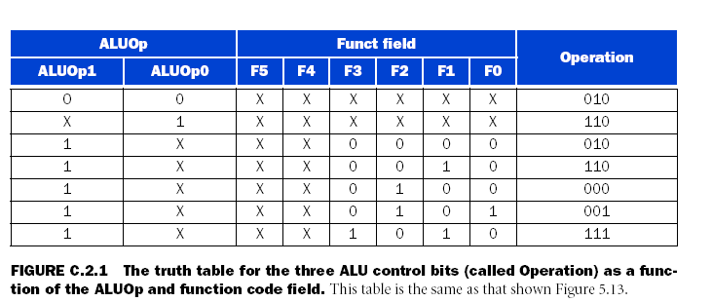
Single Cycle Control Unit: ALU control
Instr[5-0]
control
unit
Instr[31-26]
ALU
control
to ALU
ALUOp
operation
add
sub.
add
sub.
and
or
set
on less
than
On page 302, Operation has 4 bits with the first bit always zero

Slide 34
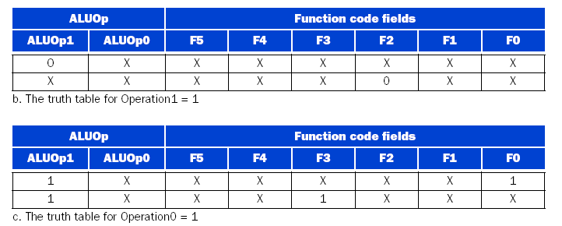

Slide 35
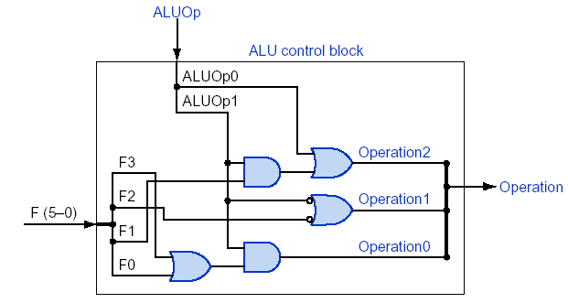
ALU Control Implementation

Slide 36
On page 301, ALU control lines = Operation
ALU control lines Function
0000 AND
0001 OR
0010 add
0110 subtract
0111 set on less than
1100 NOR

Slide 37
instruction opcode | ALUOP | Instruction operation | Funct field | Desired ALU action | ALU control input, i.e., Operation
LW | 00 | load word | xxxxxx | add | 0010
SW | 00 | store word | xxxxxx | add | 0010
Branch equal | 01 | branch equal | xxxxxx | subtract | 0110
R type | 10 | add | 100000 | add | 0010
R type | 10 | subtract | 100010 | subtract | 0110
R type | 10 | AND | 100100 | and | 0000
R type | 10 | OR | 100101 | or | 0001
R type | 10 | set on less than | 101010 | set on less than | 0111

Slide 38
Setting of the control signals
Instru-ction | RegDst | ALUSrc | Memto Reg | Reg Write | Mem Read | Mem Write | Branch | ALU Op1 | ALU Op0
R type | 1 | 0 | 0 | 1 | 0 | 0 | 0 | 1 | 0
lw | 0 | 1 | 1 | 1 | 1 | 0 | 0 | 0 | 0
sw | x | 1 | x | 0 | 0 | 1 | 0 | 0 | 0
beq | x | 0 | x | 0 | 0 | 0 | 1 | 0 | 1

Slide 39
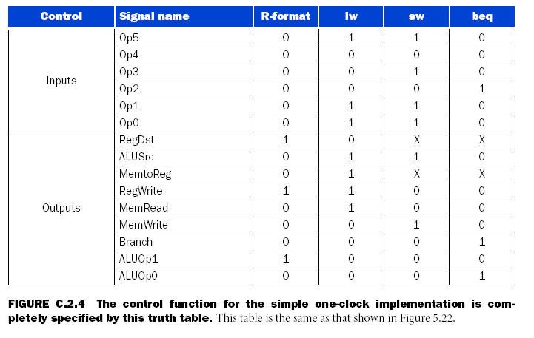

Slide 40
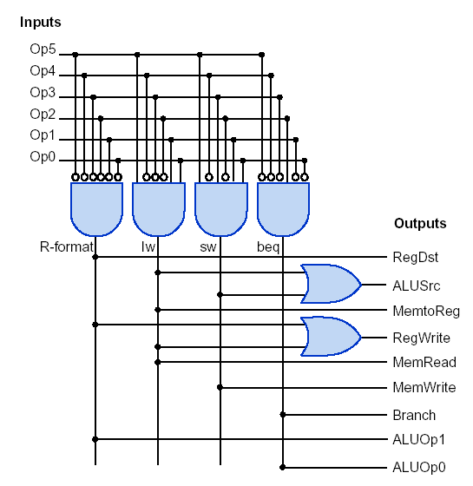
Control Unit PLA Implementation

